Slide 1
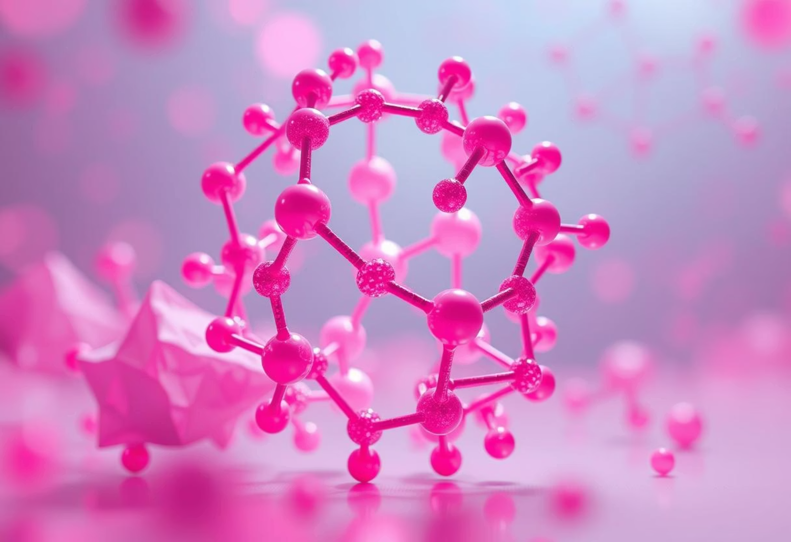
Nanotechnology: From Fundamentals to Futuristic Innovations
Manipulating Matter at the Atomic Scale
Presented by-
Abhishek Prasad
Roll No.-324406
3rd Semester , 2nd Year
Department of Computer Science
"There’s plenty of room at the bottom." — Richard Feynman

Slide 2







Journey into the Nanoverse: Our Agenda
What is Nanotech?
Historical Milestones
Tools & Techniques
(Core Concepts)
Breakthrough Applications
Recent Advancements
Ethical & Safety Challenges
(2020s)
Future Horizons

Slide 3

What is Nanotechnology?
Definition: Engineering matter at the scale of 1 to 100 nanometers (nm). To put that into perspective, 1 nm is one billionth of a meter.
Scale Analogy:
A human hair is approximately 80,000 nm wide.
A DNA strand is roughly 2.5 nm wide.
Unique Properties: At this diminutive scale, materials exhibit fascinating and often unexpected behaviours due to quantum effects, leading to enhanced strength, novel optical properties, and altered chemical reactivity. For instance, gold, typically inert, can act as a catalyst at the nanoscale and melts at room temperature, while carbon can form structures harder than diamond.

Slide 4
Historical Evolution of Nanotechnology
1959
1991
Richard Feynman's visionary lecture: "There's Plenty of Room at the Bottom," laying the theoretical groundwork for manipulating individual atoms.
Discovery of Carbon Nanotubes (CNTs) by Sumio Iijima, opening avenues for ultra-strong and conductive materials.
1
2
3
4
1981
2000s
Invention of the Scanning Tunneling Microscope (STM) by Gerd Binnig and Heinrich Rohrer, allowing scientists to 'see' and even move individual atoms.
Emergence of practical applications, including nanomedicine for targeted drug delivery and the development of quantum dots for advanced displays.

Slide 5
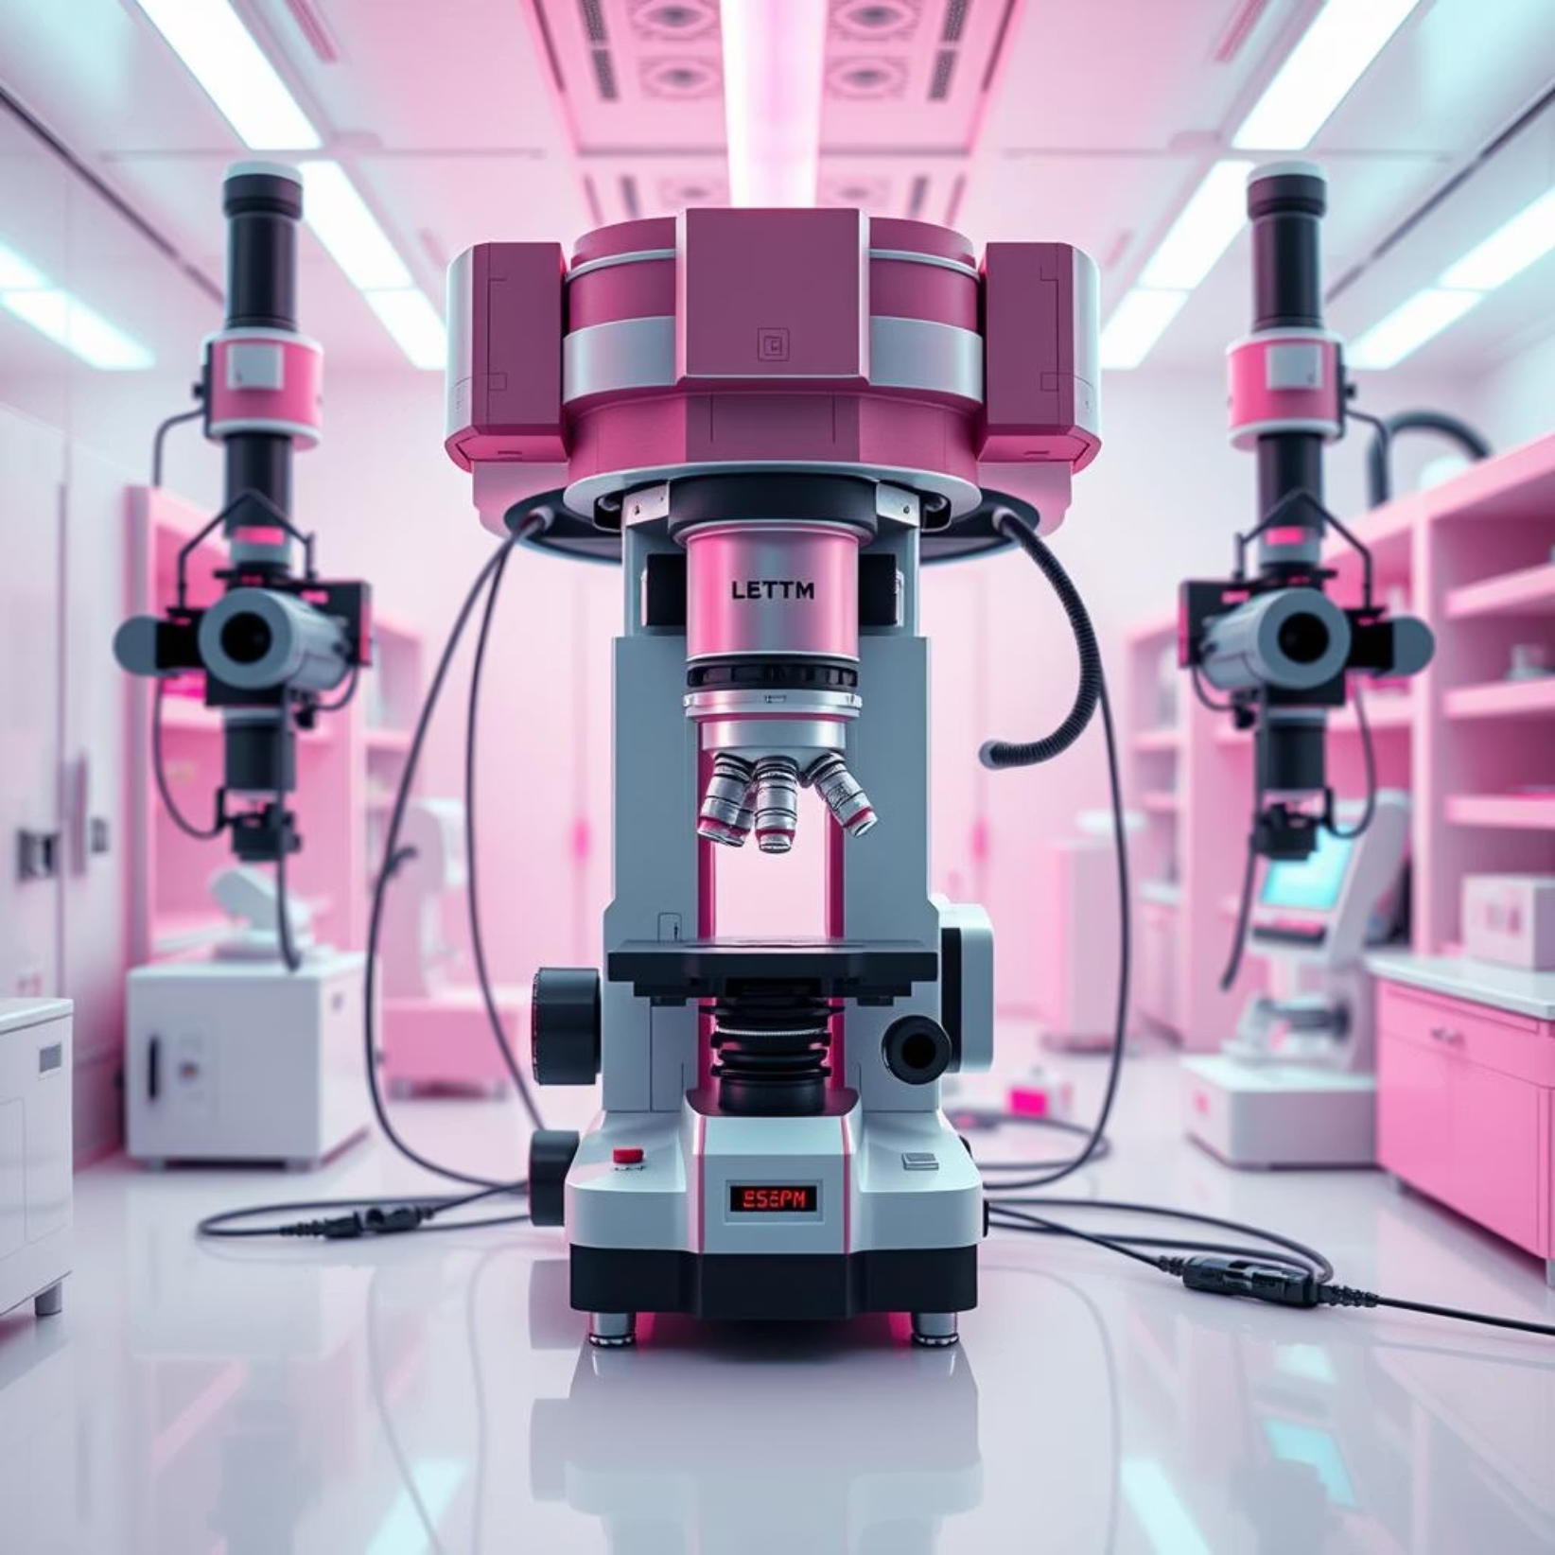
Essential Tools & Techniques for Nanoscale Manipulation
Microscopy: The eyes of the nanoworld. Instruments like the Scanning Tunnelling Microscope (STM) and Atomic Force Microscope (AFM) enable imaging and manipulation of individual atoms.
Fabrication:
Top-down: Traditional methods adapted for nanoscale, like lithography for etching nanochips.
Bottom-up: Building materials atom by atom, often leveraging self-assembly, as seen in DNA origami, where DNA strands fold into precise shapes.
Modelling: Advanced computational simulations and molecular dynamics help predict material behaviour and design at the atomic level before physical experimentation.

Slide 6




Breakthrough Applications Across Diverse Fields
Medicine
Electronics
Targeted drug delivery, lab-on-a-chip diagnostics, advanced imaging.
Nano-transistors, flexible displays, high-density data storage.
Energy
Environment
High-capacity batteries, efficient solar nanocells, improved fuel cells.
Nanofilters for water purification, pollution sensors, sustainable materials.

Slide 7

The Nanomedicine Revolution
Targeted Drug Delivery: Nanocarriers like liposomes and dendrimers can be engineered to precisely deliver therapeutic agents directly to diseased cells, such as cancer cells, significantly reducing side effects on healthy tissues. Current trials show nanoparticles reducing chemotherapy side effects by up to 60%.
Advanced Diagnostics: Gold nanoparticles are being developed for highly sensitive and rapid disease detection at early stages, offering quick and accurate diagnoses.
Precision Surgery: Though still largely experimental, the concept of nanobots performing intricate tissue repair and microsurgery holds immense promise for the future of non-invasive procedures.

Slide 8
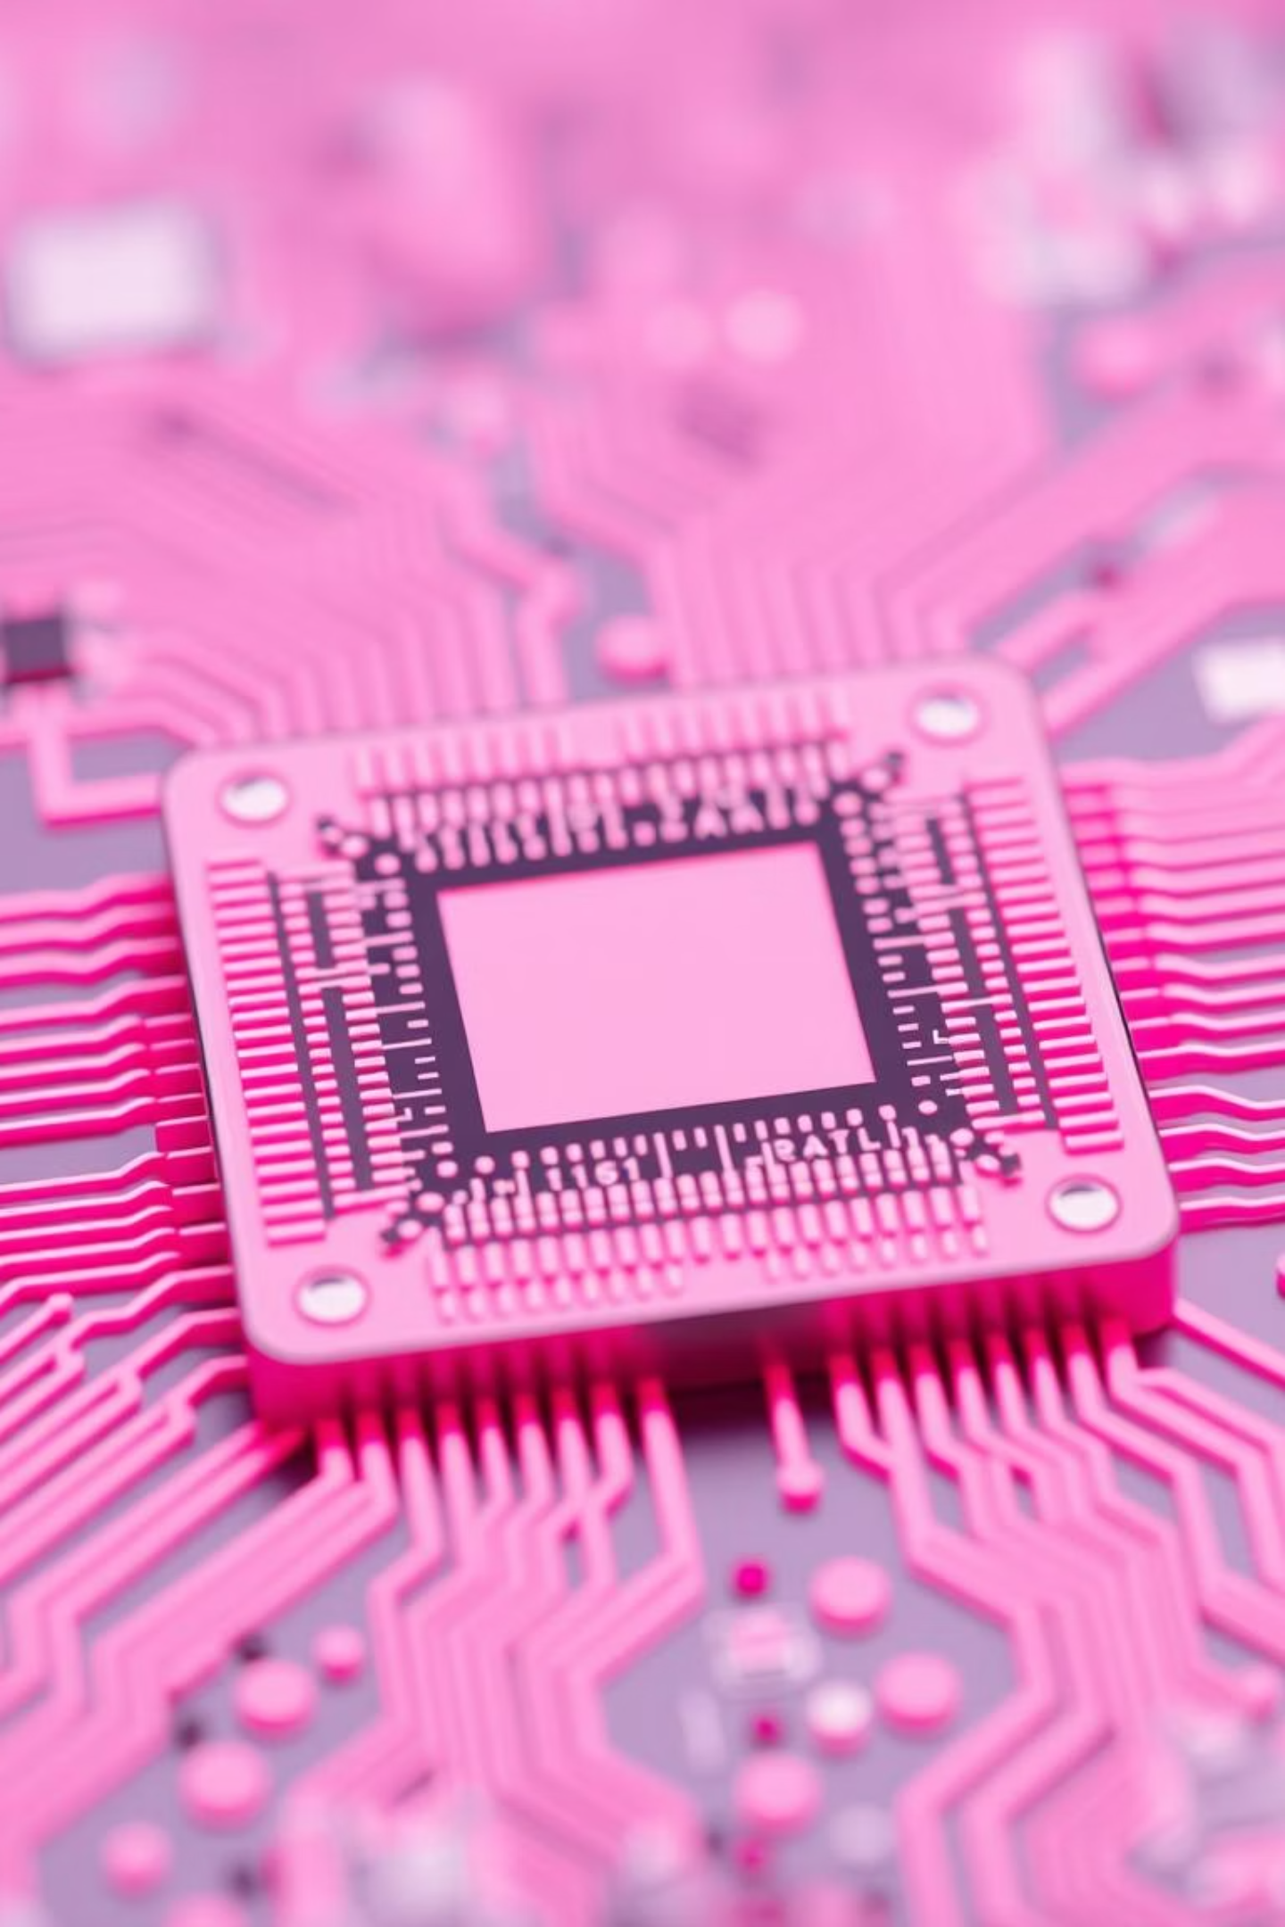
Nano-Electronics & Computing: Beyond Moore's Law
Moore's Law Extended: Nanotechnology continues to push the boundaries of miniaturisation in electronics. IBM’s 2nm chip, announced in 2021, demonstrates the ongoing ability to pack more transistors into smaller spaces, extending the lifespan of semiconductor advancements.
Quantum Computing: The fundamental building blocks of quantum computers, qubits, are increasingly being realised using quantum dots and other nanoscale structures, paving the way for unprecedented computational power.
Flexible Tech: Materials like graphene, a single layer of carbon atoms, are enabling the development of transparent, conductive, and flexible electronics for next-generation wearables and foldable devices.

Slide 9
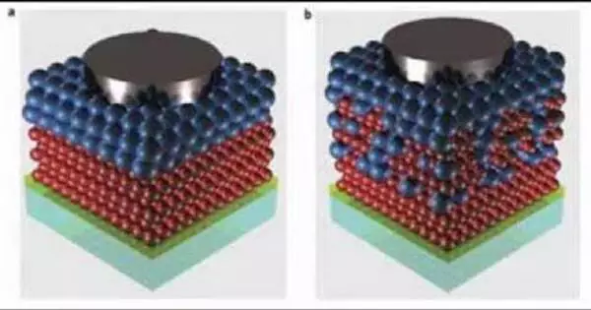
Nanotechnology for Energy & Sustainability
Revolutionary Batteries: Silicon nanowires are being developed to replace traditional graphite anodes, promising batteries with up to 10 times longer life and faster charging, as seen with innovations from companies like Sila Nanotech.
Enhanced Solar: Perovskite nanocrystals are dramatically improving solar cell efficiency, with prototypes exceeding 30%, making solar energy more competitive and accessible.
Green Hydrogen Production: Nanocatalysts are crucial for developing more efficient and cost-effective methods for producing green hydrogen, a key clean fuel for a sustainable future.

Slide 10

Cutting-Edge Advancements in the 2020s
AI + Nanotech: Machine learning is accelerating nanomaterial discovery, allowing for the rapid identification and design of new materials with desired properties, a field pioneered by entities like Google DeepMind.
CRISPR Nanocarriers: Nanoscale delivery systems are being engineered to precisely transport CRISPR gene-editing tools into specific cells, enhancing the accuracy and safety of genetic therapies.
Smart Materials: Breakthroughs include self-healing polymers that can repair themselves after damage and colour-shifting nanosensors that respond dynamically to environmental changes or chemical presence.

